Slide 1
Environment Set UP for Deep Learning

Slide 2
Contents
Create Virtual Machine through Virtual Box for Ubuntu
Install Software
Anaconda distribution of python
Tensorflow GPU
Notes:
For Anaconda:
https://problemsolvingwithpython.com/01-Orientation/01.02-The-Anaconda-Distribution-of-Python/

Slide 3
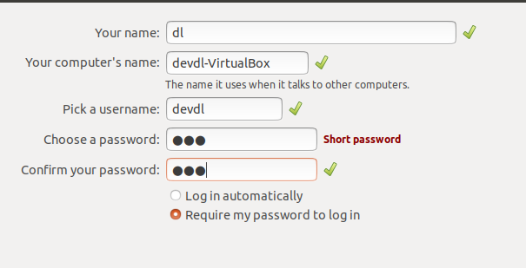
Create Virtual Machine through Virtual Box
Create Virtual Machine for Ubuntu.
Install ubuntu 18.04 Desktop ISO file.
Install ubuntu to virtual machine.
Install Ubuntu virtual box extension
Install aptitude through apt-get
Install build-essential(for gcc, g++) through aptitude with option n.
Install virtual box extension.
Notes:
For ubuntu extension:
https://www.youtube.com/watch?v=qNecdUsuTPw
For guild-essential install error:
https://ubuntuforums.org/showthread.php?t=2408234

Slide 4
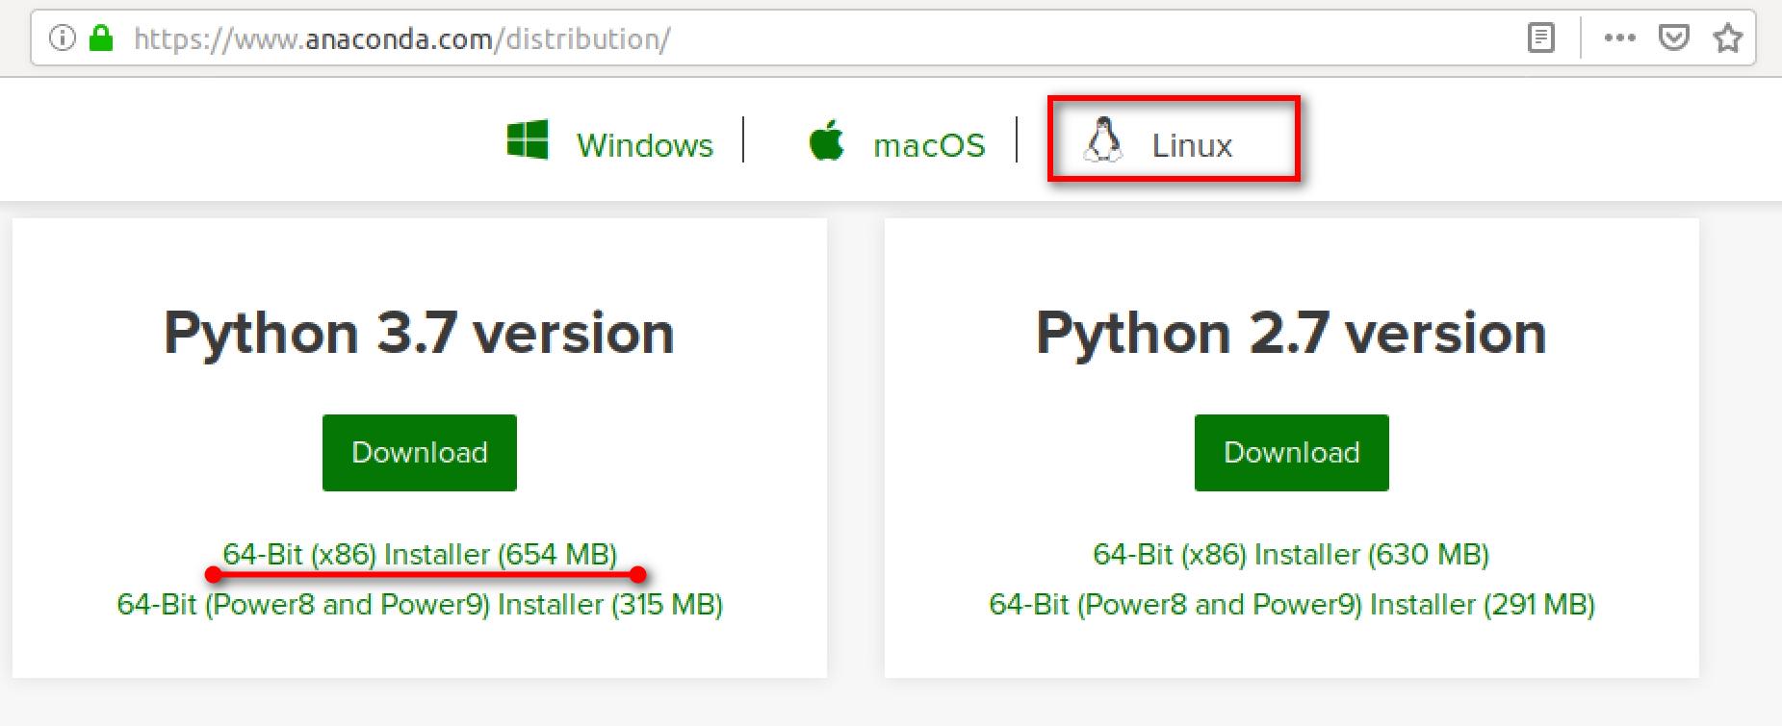
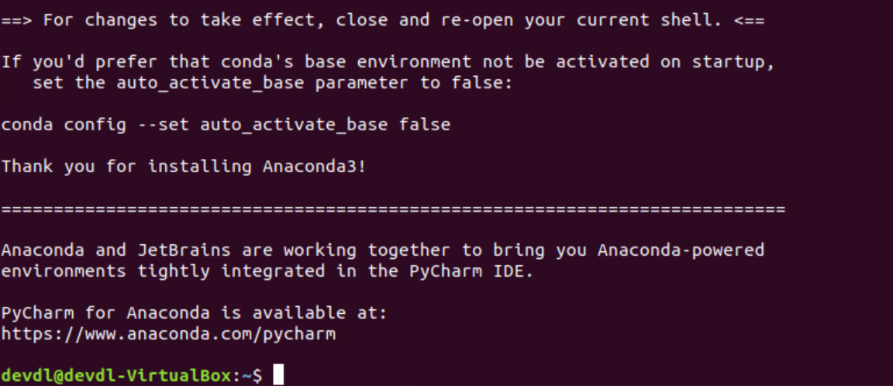
Install Software
Anaconda distribution of python
Download installer bash script from anaconda official website.
Run the anaconda installer. $bash ~/Download/Anaconda**.sh
Notes:
For anaconda:
https://docs.anaconda.com/anaconda/install/linux/
https://problemsolvingwithpython.com/01-Orientation/01.05-Installing-Anaconda-on-Linux/

Slide 5
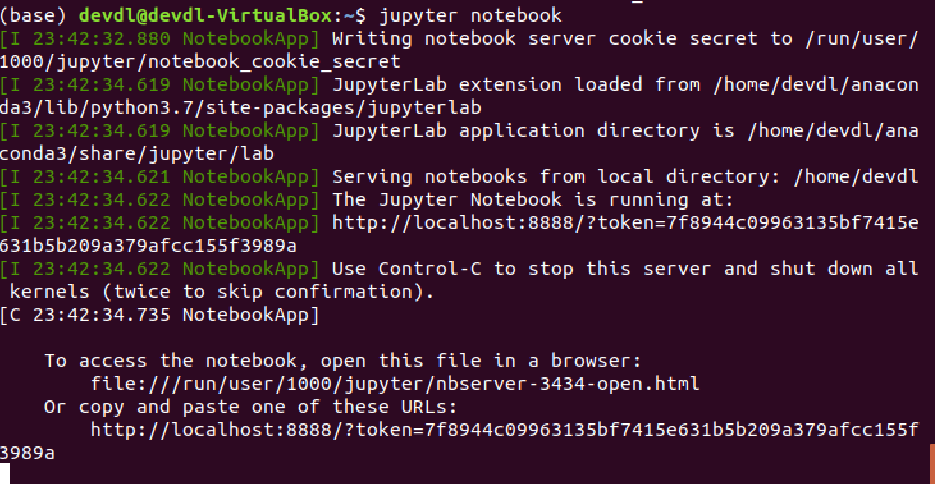
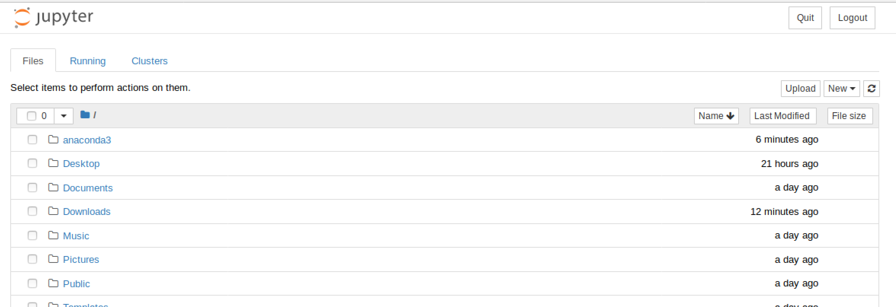
Install Software
Anaconda distribution of python
Verify (base)$jupyter notebook
Create Virtual Environment add to jupyter notebook
(base)$conda create --name tf36 python=3.6 ipykernel
(tf36)$python -m ipykernel install --user --name tf36 --display-name tf36
(base)$jupyter notebook

Slide 6
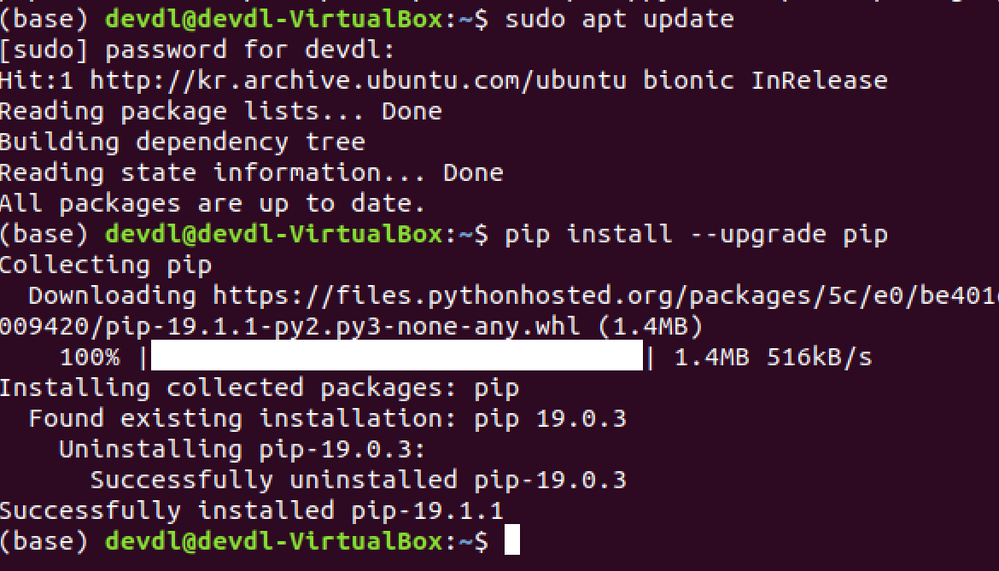
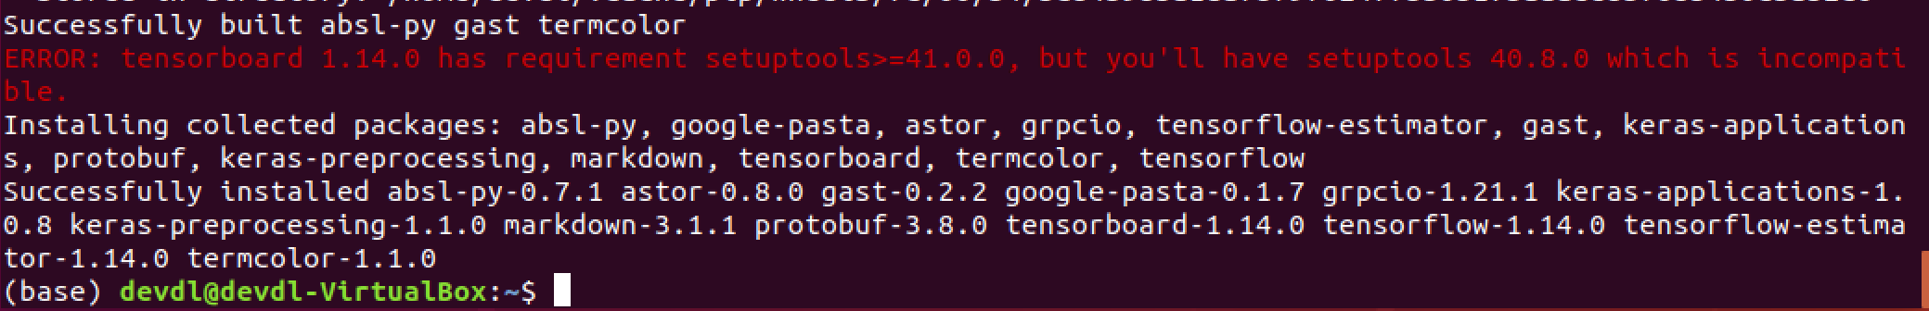
Install Software
Tensorflow CPU
(base)$sudo apt update
(base)$pip install --upgrade pip
(base)$pip install --upgrade tensorflow
Notes:
For tensorflow CPU:
https://www.tensorflow.org/install/pip
Use NVidia GPU from VirtualBox:
https://superuser.com/questions/779070/use-nvidia-gpu-from-virtualbox
For Tensorflow GPU:
https://medium.com/@naomi.fridman/install-conda-tensorflow-gpu-and-keras-on-ubuntu-18-04-1b403e740e25
Error:
https://github.com/tensorflow/tensorboard/issues/1255

